Slide 1
APA
AMERICAN PSYCHOLOGICAL ASSOCIATION
6th Edition

Slide 2
What is APA?
APA (American Psychological Association) style is most commonly used Set of rules which establishes uniform standard of written communication in social sciences concerning:
The organization of content
Writing style
Citing references

Slide 3
Why APA
Widely accepted style of documentation in writing researches, scientific journals, in many text books, in academia (for papers written in the class).
To avoid plagiarism.

Slide 4
Who Should Use APA?
APA Style describes rules for the preparation of manuscripts for writers and students in:
Social Sciences, such as Psychology, Linguistics, Sociology, Economics, and Criminology
Business
Nursing

Slide 5
APA Formatting
Paper: standard-sized paper A4 (8.5" x 11").
Uniform margins: 1" margins on all sides.
Font: Times New Roman font.
Size: 12 pt.
Space: double- spaced ( 2.0 )

Slide 6
APA Formatting…
A Running head on the top left of the page. (On every page)
Page number on the top right of the page.
No new page for Sub-sections of Main essay.
Indent the first line of each paragraph.

Slide 7
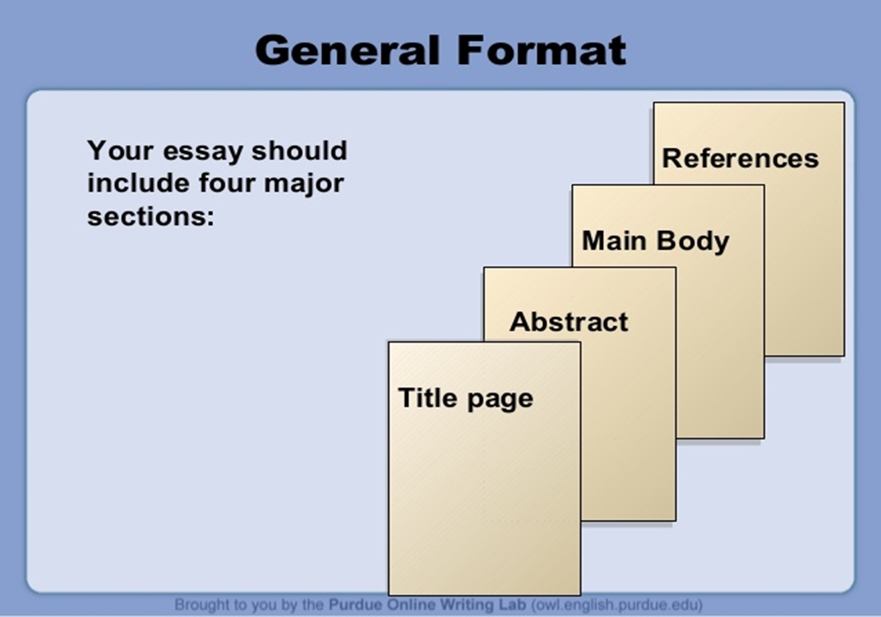
Main sections of paper
Title Page
Abstract
The main essay
References

Slide 8
Title Page

Slide 9
Elements of Title Page
Running head
Page number
Article title
Author’s name
Author's school affiliation

Slide 10
Guidelines to make Title Page
Type your title in upper and lowercase letters centered in the upper half of the page.
Title should not be more than 12 words in length and that it should not contain abbreviations
All text on the title page, and throughout your paper, should be double-spaced.
Beneath the title, type the author's name
Beneath the author's name, type the institutional affiliation, which should indicate the location where the author(s) conducted the research.

Slide 12
Body of the Paper

Slide 13
Abstract
The abstract is the 2nd page of APA-format paper.
It summarizes the key points of your paper.
Single most important paragraph.
This summary should not be indented, but should be double-spaced and should be between 150- 250 words.

Slide 14
Format of Main Essay
Uniform margins: 1" margins on all sides.
Font: Times New Roman font.
Size: 12 pt.
Space: double- spaced ( 2.0 )
Running head at the top left and page number on the top right
The first word in every paragraph should be indented one half inch.

Slide 15
Format Cont..
Indent each paragraph ‘s first line.

Slide 16
In-text Citation
An in-text citation appears in parentheses within the text of a paper, in order to indicate that a source is being cited.
Every in-text citation must correspond to a reference at the end of the paper.
In-text citations include author's last name and the publication date.
In-text citation can be done in two ways:
1. Paraphrase
2. Quotations

Slide 17
Paraphrased Information:
Summary or rephrase the source’s idea(s)
Include the Author’s name and the publication date in parentheses following the paraphrased material
Example:
According to Jones (1998), “APA style is a difficult citation format for first-time learners.”
or “APA style is a difficult citation format for first-time learners” (Jones, 1998).

Slide 18
Example
Original
Paraphrased
To the extent that a woman's self-image is challenged or threatened by an unattainable ideal of an impossibly thin female physique, she may well become susceptible to disruption of her self-regard, and may be more likely to develop an eating disorder.
If a woman interprets the media's representation of thinness as the ideal she must achieve, her sense of self-esteem might be threatened and even damaged, making her more likely to exhibit disordered eating patterns (Polivy & Herman, 2004).

Slide 19
In-Text Citation( Quotations)
Short Quotations: Provide author’s name, publication year, and the page number directly following the quotation.
Long Quotations (block quote): For direct quotations of more than 40 words, display the quote as an indented block of text without quotation marks and include the authors’ names, year, and page number in parentheses at the end of the quote.

Slide 20
Example
Short Quote
Block Quote
According to Jones (1998), "Students often had difficulty using APA style, especially when it was their first time" (p. 199).
Jones's (1998) study found the following:
Students often had difficulty using APA style, especially when it was their first time citing sources. This difficulty could be attributed to the fact that many students failed to purchase a style manual or to ask their teacher for help. (p. 199)

Slide 21
Works by Multiple Authors( In Text Citation)
One author: (Field, 2005, p.202)
Two authors: (Gass & Varoni, 1984)
Three to five authors: (Tremblay, Richer, Lachance, & Cote, 2010)
Six or more authors: (Norris-Shortle, et al., 2006)

Slide 22
Headings and Subheadings
Level 1
Centered, Boldface, Uppercase and Lowercase
Level 2
Flush Left, Boldface, Uppercase and Lowercase
Level 3
Indented, boldface, lowercase ending with a period.
Level 4
Indented, boldface, italicized, lowercase ending with a period.
Level 5
Indented, italicized, lowercase ending with a period.

Slide 23
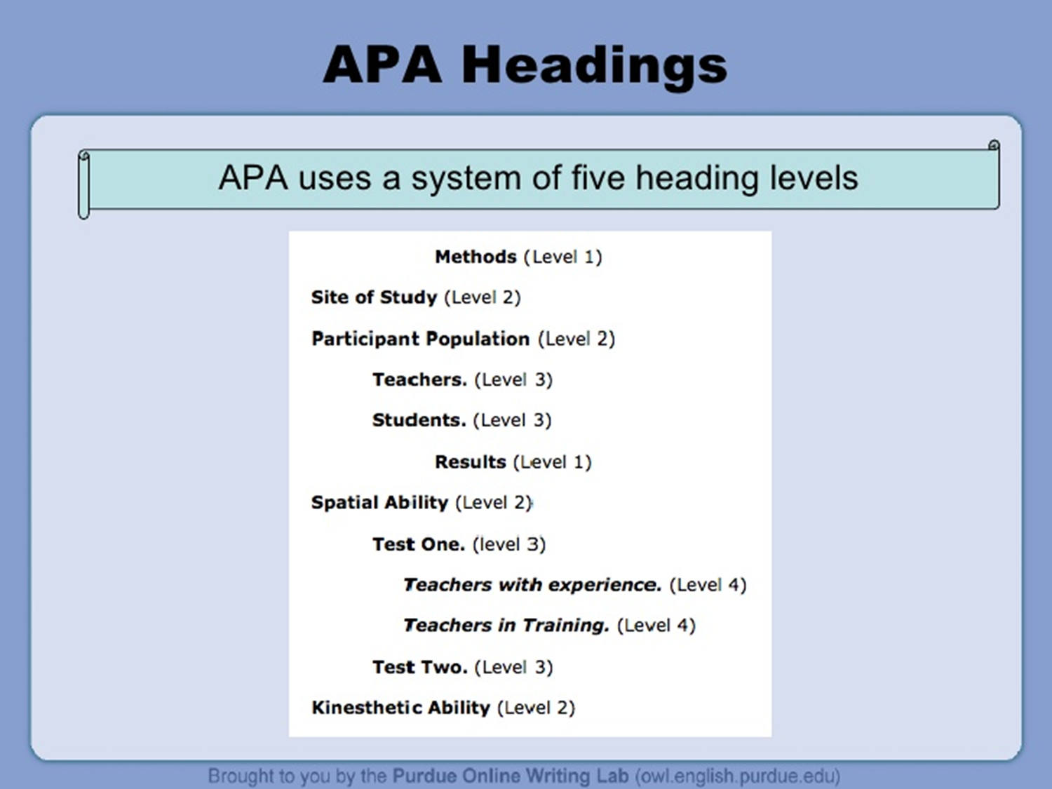

Slide 24
Seriation
If writing steps for particular task, use numbers as following:
Identify and develop your topic.
Do a preliminary search.
Locate material.
Evaluate your source.
Make notes.
Write your paper.
Cite the sources.
Proofread.

Slide 25
Seriation…
For lists that do not communicate hierarchical order or chronology, use bullets:
This version is easier to use."
Version two seems better organized."
It took me a few minutes to learn how to use this version, but after that, I felt more comfortable with it."

Slide 26
Tables in the text
Number all tables sequentially as you refer to them in the text (Table 1, Table 2, etc.
Give each table a descriptive title.
Begin the title flush left and italicize it.

Slide 27
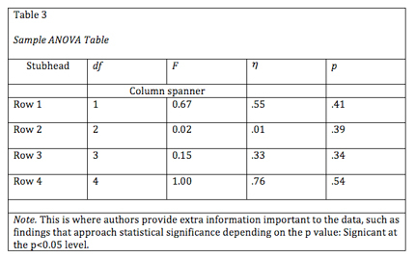
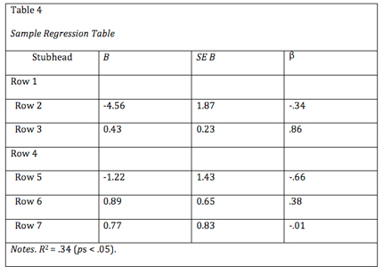

Slide 28
Images in the text
For figures, make sure to include the figure number and a title with a legend and caption.
These elements appear below the visual display.
The APA has determined specifications for the size of figures and the fonts used in them.

Slide 29
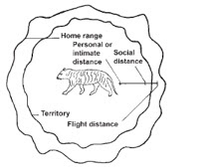
Example of Image Citation
Figure 1. Social distances of animals (Fowler, 2008, p. 13)

Slide 30
References Page

Slide 31
Basic rules of References Page
On a new page, write your references.
Center the title References(do not include quotation marks, underline, or italicize this title)
All lines after the first line of each entry in your reference list should be indented one-half inch from the left margin
Alphabetize and Double-space all entries

Slide 32
Rules cont...
Every article/source mentioned in the paper and used in your study should be referenced and have an entry
The names or titles of journals, books, CDs, television and radio programs, plays, films, and operas are italicized.
Do not italicize, underline, or put quotes around the titles of shorter works such as journal articles or essays in edited collections.

Slide 33
THERAPY DOGS IN LIBRARIES 7
References
AngelDocs. (2012, October 7). William & Kate: The first year [Video file].
Retrieved from https://www.youtube.com/watch?v=5WZdFPkLhQM
Boudarbat, B. (2008). Field of study choice by community college students in
Canada. Economics of Education Review, 27(1), 79-93.
Keohane, R.O. & Nye, J.S. (2012). Power and interdependence (4th ed.). Boston, MA: Longman.

Slide 34
Books in APA-style reference list
Note: Citations with more than one line of text should have hanging indent of 1/2 inch or 5 spaces.
Important Elements and sequence:
Author (last name, initials only for first & middle names)
Publication date
Title (in italics; capitalize only the first word of title and subtitle, and proper nouns)
Place of publication
Publisher

Slide 35
Book by one Author
Book by one Author:
Ball, E.(2000). Slave in the Family. New York, NY: Hand Press.
If an editor, put the abbreviation Ed. In parentheses after the name. Example:
Ball, E.(Ed.).(2000). Slave in the Family. New York, NY: Hand Press.

Slide 36
Book by two Authors
Join two authors’ names with a comma and ampersand.
Example:
Goodpaster, K. , & Nash, L. L. (2006). Business ethics: Policies and persons (3rd ed.). Boston, MA: McGraw-Hill/Irwin.

Slide 37
Book by three or more authors
Write out all of the authors’ names up to seven. For works with eight or more authors, write out first six names, add an ellipsis mark (…), and give last author’s name.
Example:
Konishi,C. ,Hymel,s., Zumbo,B., Li, Z., Taki, M., Slee, P., … Kwak,K.
(ellipsis)

Slide 38
Journal
Author, I. N. (Year). Title of the article. Title of the Journal or Periodical, volume number, page numbers.( format)
Smith, L. V. (2000). Referencing articles in APA format. APA Format Weekly, 34,4-10

Slide 39
Newspaper Articles:
References for newspaper articles follow the basic structure, but use the initials p. or pp. to denote page numbers.
For example:
Tensky, J. A. (2004, January 5). How to cite newspaper articles. The New York Times, pp. 4, 5.

Slide 40
Web Page
Lee, J. (1997). Kinship and family ties. Retrieved from http://www.postcolonialweb.org/nz/maorijlg2b.html
In-text citation (Lee, 1997)

Slide 41
Thank you

